Slide 1
Wireless and Mobile Security
Lesson Introduction
WiFi security
iOS security
Android security
Notes:
Headshot

Slide 2
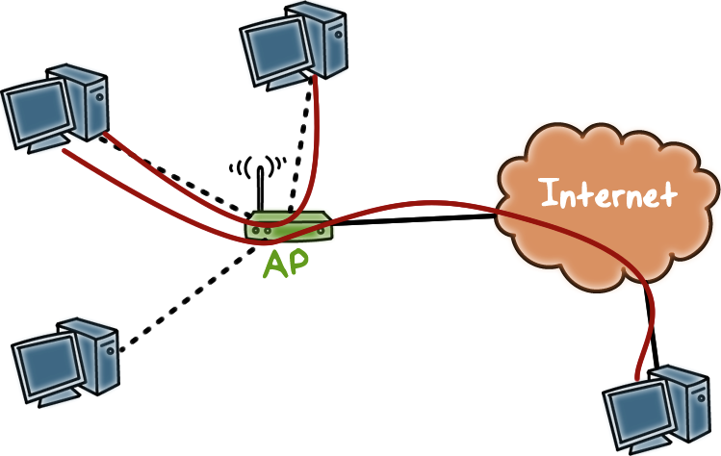
Introduction to WiFi
Notes:
A typical use of WiFi is to allow personal computers, or devices enabled with WiFi, in a locale, such as a home, to access the Internet through the Access Point (or, AP). The AP connects to these devices wirelessly and connects to the Internet via physical wiring, such as to a router provided by the Internet Service Provider.
Devices in a locale can also connect to each other wirelessly through the AP.

Slide 3

Introduction to WiFi
No inherent physical protection
Broadcast communications
Notes:
In wireless networking, data is not transmitted via physical wires, instead, data is transmitted in air, which is an open medium. In other words, there is no inherent physical protection of communications.
Also, since there is no hard wire connecting two devices for direct communications, in wireless networking, communication between two devices is achieved by one device broadcasting and the other device listening to the broadcast.

Slide 4

WiFi Quiz
Select all that apply.
Which of the following are security threats to WiFi:
Eavesdropping
Injecting bogus messages
Replaying previously recorded messages
Illegitimate access to the network & its services
Denial-of-service
All the above
Notes:
QUIZ:
Discuss
---
SOLUTION:
Answer: F

Slide 5

Overview of WiFi Security
Early solution was based on WEP
seriously flawed
not recommended to use
New security standard for WiFi is 802.11i, implemented as WiFi Protected Access II (WPA2)
Notes:
The earlier WiFi security standard, Wired Equivalent Privacy, or, WEP, has been shown to be easily breakable even when correctly configured.
The new standard is 802.11i, implemented as WPA2.

Slide 6

Overview of 802.11i
Main advantages over WEP
access control model is based on 802.1X
flexible authentication framework (based on EAP – Extensible Authentication Protocol)
Carrier protocol designed to transport the messages of real authentication protocols (e.g., TLS – Transport Layer Security)
Notes:
802.11i enforces access control, which is based on another standard called 802.1x.
802.1X is flexible because it's based on Extensible Authentication Protocol. EAP is a highly pliable standard. 802.1x encompasses the range of EAP authentication methods, including MD5, TLS, etc.

Slide 7
Overview of 802.11i
Main advantages over WEP
authentication process results in a shared session key (which prevents session hijacking)
different functions (encryption, integrity) use different keys derived from the session key using a one-way function
integrity protection is improved
encryption function is improved
Notes:
More advanced EAP types such as TLS provide mutual authentication, which limits man-in-the-middle threats by authenticating the server to the client, in addition to just the client to the server. Furthermore, these EAP methods result in keying material, which can be used to generate dynamic encryption keys.
802.11i also uses different keys for encryption vs. integrity protection. It also uses AES, which is a stronger encryption method.

Slide 8
WiFi Security Standards Quiz
Choose the best answer:
Which security standard should be used for WiFi?
WEP
WPA2
Notes:
QUIZ:
Discuss
---
SOLUTION:
Answer B

Slide 9
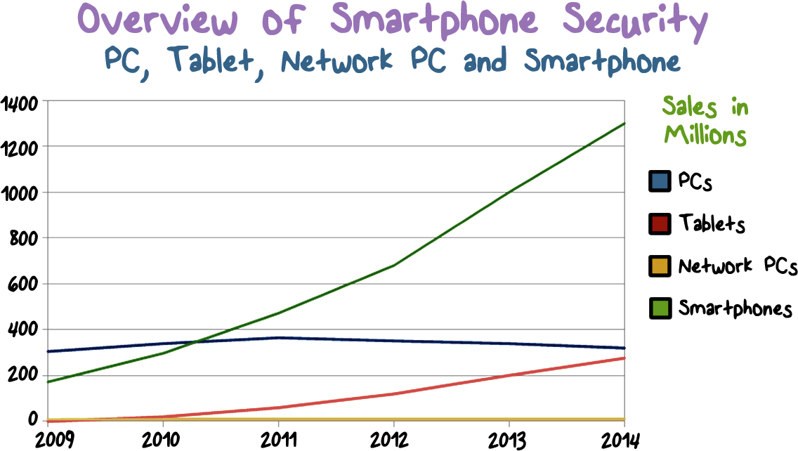
Notes:
It is clear that more people are using smartphones, and are using them for more and more important tasks.
Let’s take a brief look at the security of smartphones.

Slide 10

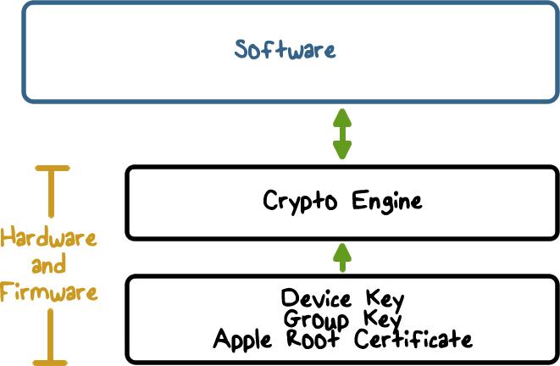
Overview of iOS Security
Notes:
Here is an overview of the iOS security architecture.
First, it combines software and hardware features to provide security to an iOS device.
Second, it has built-in crypto capabilities to support data protection such as confidentiality and integrity.
Third, it provides strong isolation mechanisms, e.g., app sandbox to protect App security: it enables apps to run securely and without compromising platform integrity.

Slide 11
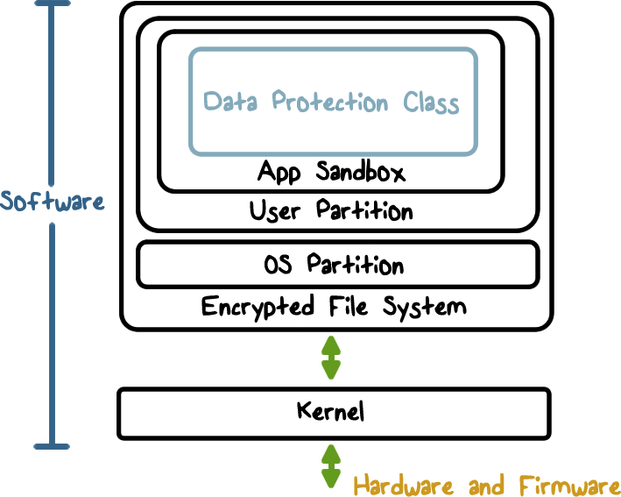
Overview of iOS Security
Notes:
Here is an overview of the iOS security architecture.
First, it combines software and hardware features to provide security to an iOS device.
Second, it has built-in crypto capabilities to support data protection such as confidentiality and integrity.
Third, it provides strong isolation mechanisms, e.g., app sandbox to protect App security: it enables apps to run securely and without compromising platform integrity.

Slide 12
Operating System
Vulnerabilities Quiz
Select three operating systems with the most vulnerabilities in 2014:
Apple iOS
Microsoft Windows Server 2012
Microsoft Windows 7
Apple Mac OS X
Linux Kernel
Microsoft Windows Vista
Microsoft Windows 8
Notes:
QUIZ:
All operating systems have vulnerabilities. Select the OS with the most vulnerabilities in 2014.
---
SOLUTION:
Answers:
#1. Apple MAC OS X
#2. Apple iOS
#3. Linux Kernel
This is an interesting quiz in that it appears to dispel the idea that Apple platforms are inherently more secure.
The increase in vulnerabilities may be due to the fact that Apple accounts for a high percentage of smartphone activation. Which makes it a very big target for hackers

Slide 13
Hardware Security Feature
Each iOS device has a dedicated AES-256 crypto engine
Manufacture Keys
Apple provides the Device ID (UID) and the device group ID (GID) as AES 256 Bit keys
While the UID is unique to each device, the GID represents a processor class (e.g., Apple A5 processor)
The UID and GID keys are directly burned into the silicon and can only be accessed by the Crypto Engine
Notes:
iOS devices have crypto capabilities built into hardware.
Every iOS device has a dedicated AES 256 crypto engine built into the Direct Memory Access (or, DMA) path between the flash storage and main system memory, making file encryption highly efficient.
The device’s unique ID (UID) and a device group ID (GID) are AES 256-bit keys fused (UID) or compiled (GID) into the application processor and Secure Enclave during manufacturing. No software or firmware can read them directly; they can see only the results of encryption or decryption operations performed by dedicated AES engines implemented in silicon using the UID or GID as a key.
The UIDs are unique to each device and are not recorded by Apple or any of its suppliers. The GIDs are common to all processors in a class of devices (for example, all devices using the Apple A8 processor), and are used for non security-critical tasks such as when delivering system software during installation and restore.
Integrating these keys into the silicon helps prevent them from being tampered with or bypassed, or accessed outside the AES engine.

Slide 14

iOS Trusted Bootchain
Notes:
The security of a device should be established when the device is turned on initially.
----
When an iOS device is turned on, its application processor immediately executes code from read-only memory known as the Boot ROM. This immutable code, known as the hardware root of trust, is laid down during chip fabrication, and is implicitly trusted. The Boot ROM code contains the Apple Root CA public key, which is used to verify that the Low-Level Bootloader (LLB) is signed by Apple before allowing it to load. This is the first step in the chain of trust where each step ensures that the next is signed by Apple.
---
When the LLB finishes its tasks, it verifies and runs the next-stage bootloader, iBoot, which in turn verifies and runs the iOS kernel.
This secure boot chain helps ensure that the lowest levels of software are not tampered with and allows iOS to run only on validated Apple devices.

Slide 15
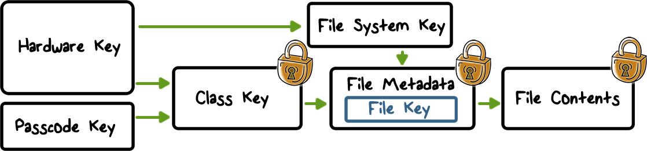
File Data Encryption
Every file is encrypted with a unique File Key, that is generated when the file is created
The file key is wrapped with a Class Key and stored in the file‘s metadata
The metadata is encrypted with the File System Key
The Class key is protected by the Device UID and (if configured for some files) the User Passcode
Notes:
In addition to the hardware encryption features built into iOS devices, Apple uses a technology called Data Protection to further protect data stored in flash memory on the device. Data Protection allows the device to respond to common events such as incoming phone calls, but also enables a high level of encryption for user data. Key system apps, such as Messages, Mail, Calendar, Contacts, Photos, and Health data values use Data Protection by default, and third-party apps installed on iOS 7 or later receive this protection automatically.
Data Protection is implemented by constructing and managing a hierarchy of keys, and builds on the hardware encryption technologies built into each iOS device. Data Protection is controlled on a per-file basis by assigning each file to a class; accessibility is determined by whether the class keys have been unlocked.
---
Every time a file on the data partition is created, Data Protection creates a new 256-bit key (the “per-file” key) and gives it to the hardware AES engine, which uses the key to encrypt the file as it is written to flash memory using AES CBC mode. The initialization vector (IV) is calculated with the block offset into the file and encrypted with the SHA-1 hash of the per-file key.
The per-file key is wrapped with one of several class keys, depending on the circumstances under which the file should be accessible. The wrapped per-file key is stored in the file’s metadata.
---
When a file is opened, its metadata is decrypted with the file system key, revealing the wrapped per-file key and a notation on which class protects it. The per-file key is unwrapped with the class key, then supplied to the hardware AES engine, which decrypts the file as it is read from flash memory.
The metadata of all files in the file system is encrypted with a random key, which is created when iOS is first installed or when the device is wiped by a user.
----
The content of a file is encrypted with a per-file key, which is wrapped with a class key and stored in a file’s metadata, which is in turn encrypted with the file system key. The class key is protected with the hardware UID and, for some classes, the user’s passcode.
This hierarchy provides both flexibility and performance. For example, changing a file’s class only requires rewrapping its per-file key, and a change of passcode just rewraps the class key.

Slide 16
Security Quiz
Mark all the answers that are true.
All cryptographic keys are stored in flash memory
Trusted boot can verify the kernel before it is run
All files of an app are encrypted using the same key
Notes:
QUIZ:
Discuss
---
SOLUTION:
1. F. 2. T. 3. F

Slide 17

Mandatory Code Signing
All executable code has to be signed by a trusted party
Apps from App Store are signed by Apple
No dynamic code generation or self-modifying
Notes:
Once the iOS kernel has started, it controls which user processes and apps can be run.
To ensure that all apps come from a known and approved source and have not been tampered with, iOS requires that all executable code be signed using an
Apple-issued certificate. Apps provided with the device, like Mail and Safari, are signed by Apple. Third-party apps must also be validated and signed using an
Apple-issued certificate. Mandatory code signing extends the concept of chain of trust from the OS to apps, and prevents third-party apps from loading unsigned code resources or using self- modifying code.

Slide 18
Mandatory Code Signing
Code signing check
Enforced by kernel, handled by a user-space daemon
Mandatory code signing
Notes:
At runtime, code signature checks of all executable memory pages are made as they are loaded to ensure that an app has not been modified since it was installed or last updated.

Slide 19
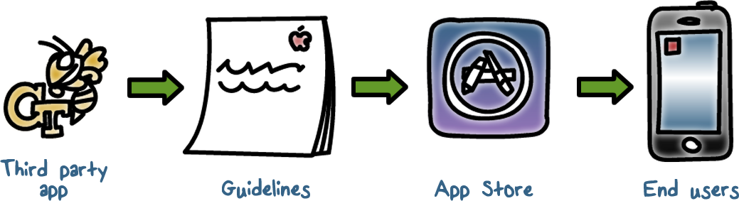
Restricted App Distribution Model
Third-party apps have to be reviewed by Apple. The apps that passed the review are signed by Apple
iOS devices are only allowed to download apps through the App Store
Notes:
In order to develop and install apps on iOS devices, developers must register with Apple and join the iOS Developer Program. The real-world identity of each developer, whether an individual or a business, is verified by Apple before their certificate is issued. This certificate enables developers to sign apps and submit them to the App Store for distribution. As a result, all apps in the App Store have been submitted by an identifiable person or organization, serving as a deterrent to the creation of malicious apps. They have also been reviewed by Apple to ensure they operate as described and don’t contain obvious bugs or other problems.

Slide 20
App Store Security Quiz
Choose the best answer
In 2013 researchers were able to bypass Apple’s App store security. What method did they use?
Uploaded malware disguised as an app without authorization, bypassing the review and check process.
Uploaded an app that after it passed the review process morphed into malware.
Uploaded an app that led users to a site that contained malware.
Notes:
QUIZ:
In 2013 researchers here at Georgia Tech were able to bypass Apple’s App store security. What method did they use?
---
SOLUTION:
In the spirit of full disclosure, I was one of the researchers. A link to an article about the research can be found in the instructor’s notes.
Correct answer, an app was uploaded that morphed into malware.

Slide 21
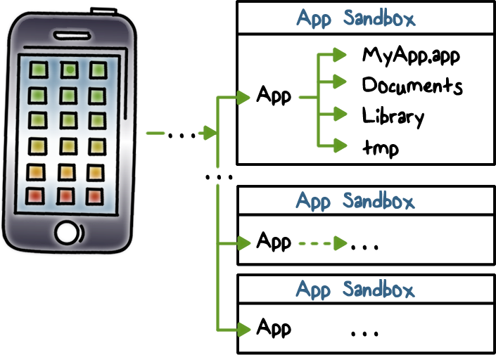
Sandboxing
Each app has a unique home directory for its files
Apps are restricted from accessing files stored by other apps or from making changes to the device
Notes:
Once an app is verified to be from an approved source, iOS enforces security measures designed to prevent it from compromising other apps or the rest of the system.
All third-party apps are “sandboxed,” so they are restricted from accessing files stored by other apps or from making changes to the device. This prevents apps from gathering or modifying information stored by other apps. Each app has a unique home directory for its files, which is randomly assigned when the app is installed. If a third-party app needs to access information other than its own, it does so only by using services explicitly provided by iOS.
----
System files and resources are also shielded from the user’s apps. The majority of iOS runs as the non-privileged user “mobile,” as do all third-party apps.
The entire OS partition is mounted as read-only. Unnecessary tools, such as remote login services, aren’t included in the system software, and APIs do not allow apps to escalate their own privileges to modify other apps or iOS itself.

Slide 22
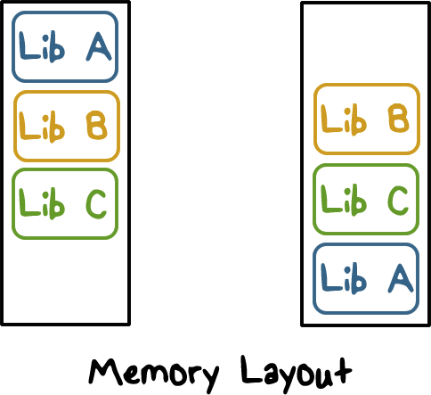
Address Space Layout Randomization
Stack, heap, main executable, and dynamic libraries.
Notes:
Address space layout randomization (ASLR) protects against the exploitation of memory corruption bugs. Built-in apps use ASLR to ensure that all memory regions are randomized upon launch. Randomly arranging the memory addresses of executable code, system libraries, and related programming constructs reduces the likelihood of many sophisticated exploits. For example, a return-to-libc attack attempts to trick a device into executing malicious code by manipulating memory addresses of the stack and system libraries.

Slide 23
Apple Security Quiz
Choose the best answer
What weaknesses were exploited by researchers in the Apple apps security in 2015?
The malware was uploadable to the Apple Apps store.
The malware was able to bypass Sandbox security
The malware was able to hijack browser extensions and collect passwords.
All of the above.
Notes:
QUIZ:
In June 2015 researchers discovered a major security flaw in the iOS X..
Based on what we have discussed so far, select areas where you think weaknesses were exploited.
---
SOLUTION:
Correct answer -- all of the above
The link in the instructor notes point to a paper on this topic.
Researchers will able to upload malware to the Apple app store, shattering the notion that the app store was totally secure.
The app was able to bypass Sandbox security and access the keychain.
It was also able to hijack browser extension and delete passwords. The app then collected the passwords when the user re-entered them.

Slide 24
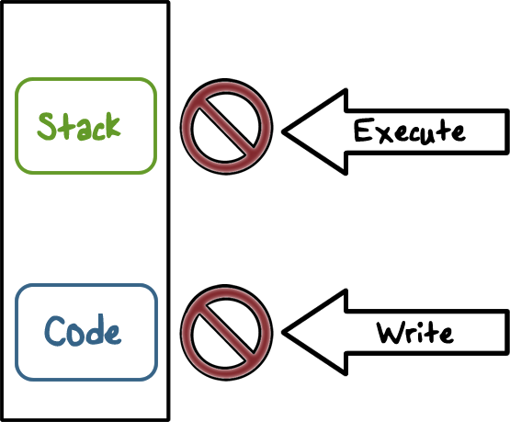
Data Execution Prevention
Notes:
Further protection is provided by iOS using ARM’s Execute Never (XN) feature, which marks memory pages as non-executable. Memory pages marked as both writable and executable can be used only by apps under tightly controlled conditions: The kernel checks for the presence of the Apple-only dynamic code-signing entitlement.

Slide 25

Data Execution Prevention
Stack and Heap are not executable
W^X policy enforced on code pages
Prevents code-injection attacks
Notes:
This feature prevents code-injection attacks where memory-based exploit such a buffer-overflow is used to write malicious code on stack or in memory and force execution to jump to the malicious code. W^X means that if a page is writable, meaning that new data or code can be written on the memory page, then this page is not executable.

Slide 26

Passcodes and Touch ID
Touch ID provides convenience
Passcode enables data protection
Maximum failed attempts
Progressive passcode timeout
Notes:
To prevent unauthorized use of a device, a user can use passcodes and touch ID.
Touch ID is the fingerprint sensing system that makes secure access to the device faster and easier.
By setting up a device passcode, the user automatically enables Data Protection.
iOS supports four-digit and arbitrary-length alphanumeric passcodes.
To further discourage brute-force passcode attacks, the iOS interface enforces escalating time delays after the entry of an invalid passcode at the Lock screen. Users can choose to have the device automatically wiped if the passcode is entered incorrectly after 10 consecutive attempts.

Slide 27
iOS Quiz
Mark all the true answers
Each app runs in a sandbox and has its own home directory for its files
All iOS apps must be reviewed and approved by Apple
iOS apps can be self-signed by app developers
Notes:
QUIZ:
Discuss
---
SOLUTION:
Answers: 1. T. 2. T. 3. F

Slide 28
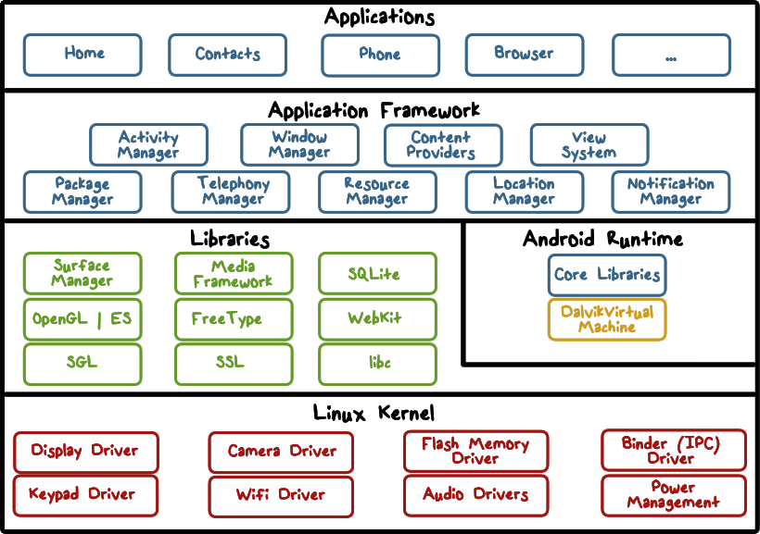
Android Security Overview
Notes:
Here is the overview of the architecture of Android, which is based on Linux.
Android is implemented in the form of a software stack architecture consisting of a Linux kernel, a runtime environment and corresponding libraries, an application framework and a set of applications.
Applications are predominantly written in Java and run within individual instances of the Dalvik virtual machine. The key goals of the Android architecture are performance and efficiency, both in application execution and in the implementation of reuse in application design.
----
At the lowest level is the Linux kernel. It provides a level of abstraction between device hardware and the upper layer of the Android software stack.
----
Each application running on an Android device runs its own instance of the Dalvik virtual machine (VM). Programs are commonly written in Java and compiled to bytecode for the Java virtual machine, which is then translated to Dalvik bytecode. The compact Dalvik Executable format is designed for systems such as smartphones that are constrained in terms of memory and processor speed.
----
The Android Core libraries are Java-based libraries for application development, e.g., for web browsing, data access and database queries, graphics rendering, etc.
The Android Core libraries do not actually perform much of the actual work and are, in fact, essentially Java “wrappers” around a set of C/C++ based libraries. When making calls, for example, to the android.opengl library to draw 3D graphics on the device display, the library actually ultimately makes calls to the OpenGL ES C++ library which, in turn, works with the underlying Linux kernel to perform the drawing tasks.
C/C++ libraries are included to fulfill a wide and diverse range of functions including 2D and 3D graphics drawing, Secure Sockets Layer (SSL) communication, SQLite database management, audio and video playback, bitmap and vector font rendering, display subsystem and graphic layer management and an implementation of the standard C system library (libc).
----
The Application Framework is a set of services that collectively form the environment in which Android applications run and are managed. This framework implements the concept that Android applications are constructed from reusable, interchangeable and replaceable components. This concept is taken a step further in that an application is also able to publish its capabilities along with any corresponding data so that they can be found and reused by other applications.
----
Located at the top of the Android software stack are the applications. These comprise both the native applications provided with the particular Android implementation (for example web browser and email applications) and the third party applications installed by the user after purchasing the device.

Slide 29

Application Sandbox
Each application runs with its UID in its own Dalvik virtual machine
Provides CPU protection, memory protection
Applications announces permission requirement
Create a whitelist model – user grants access
Ask user at install time
Inter-component communication reference monitor checks permissions
Notes:
Running applications in virtual machines provides a number of advantages. Firstly, applications are essentially sandboxed, in that they cannot detrimentally interfere (intentionally or otherwise) with the operating system or other applications, nor can they directly access the device hardware. Secondly, this enforced level of abstraction makes applications platform neutral in that they are never tied to any specific hardware.
Each app (UID) is granted a set of logical permissions at install time, and cannot perform operations (call APIs) that require permissions it doesn't have.
More specifically, the Android platform takes advantage of the Linux user-based protection as a means of identifying and isolating application resources. The Android system assigns a unique user ID (UID) to each Android application and runs it as that user in a separate process. The kernel enforces security between applications and the system at the process level through standard Linux facilities, such as user and group IDs that are assigned to applications. By default, applications cannot interact with each other and applications have limited access to the operating system. If application A tries to do something malicious like read application B's data or dial the phone without permission (which is a separate application), then the operating system protects against this because application A does not have the appropriate user privileges. The sandbox is simple, auditable, and based on decades-old UNIX-style user separation of processes and file permissions.
Android permissions are typically implemented by mapping them to Linux groups that have the necessary read/write access to relevant system resources (files or sockets) and thus are ultimately enforced by the Linux kernel.

Slide 30

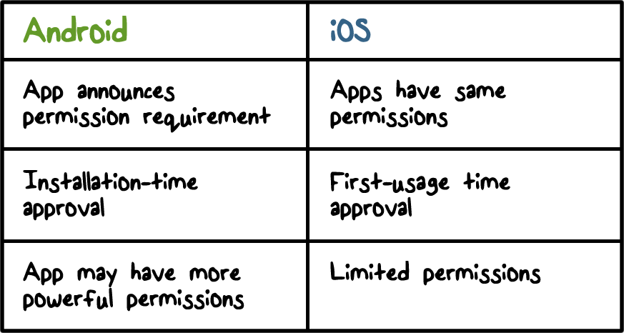
Android Sandbox vs iOS Sandbox
Notes:
In a comparison between Android and iOS sandbox the main difference is how permissions are granted.

Slide 31
Code Signing
All apps self-signed by developers
Code signing is used for
Facilitating application upgrades
Code/data sharing between applications
Lets apps run in the same process
Notes:
Code signing is used for making sure updates for an app are coming from the same author (same origin policy), and establishing trust relationships between applications.

Slide 32
Android Apps Quiz
Mark all the true answers
Android apps can be self-signed
Android apps can have more powerful permissions than iOS apps
Notes:
QUIZ:
Discuss
---
SOLUTION:
Answers: 1. T. 2. T.

Slide 33
Wireless and Mobile Security
Lesson Summary
Use WPA2 for WiFi security
iOS has cryptographic keys and modules built into its device hardware, uses mandatory code signing and a very restricted app distribution model, and runs app in a sandbox with run-time protection such as ASLR and DEP
Android is based on Linux and the sandbox model is based on Unix-style user separation, and its apps are self-signed
Notes:
Headshot

